Slide 1
Introduction to Python: Repetition Statements (Loops)
APRIL 2024
EPAM Proprietary & Confidential.

Slide 2
Contents
01
Introduction to Loops
02
Type of Loops
03
Are you trapped in an infinite Loop?

Slide 3
Let’s use Git to save our job Today
Before start, make sure you have cloned the repository from:
https://github.com/ericrommel/ekids
$ cd path/to/your/local/repository
$ git checkout main
$ git pull
$ git checkout YOUR_BRANCH_HERE
$ git merge main
Let’s have fun…

Slide 4
Introduction to Loops
What is a loop?
It is a way to repeat actions in a computer program
Imagine asking your robot to pick up all the toys in your room. Instead of telling it each step for each toy, you just say:
“Hey, keep picking up toys until the room is clean!”
That's what a loop does in programming.
FOR Loop
WHILE Loop
NESTED Loop

Slide 5
Type of Loops
FOR statement
When you KNOW how many times to repeat
Looping
Start
print(“My name is“)
for i in range(5)
print(f“John Peter ({i})“)
End

Slide 6
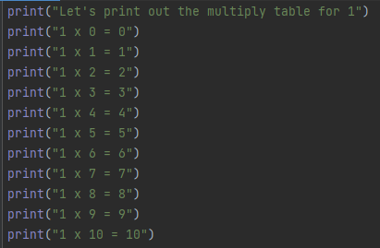
Type of Loops
Example: How to write a multiply table for the number 1? And 2? And 3? And so on???

Slide 7
Type of Loops
Example: How to write a multiply table for the number 1? And 2? And 3? And so on???
Now, try it using for statement

Slide 8
Type of Loops
WHILE statement
It repeats based on a condition. Example: "Continue playing the game until dinner is ready."
True
Start
print(“My name is …“)
spam < 5
False
spam = spam + 1
End

Slide 9
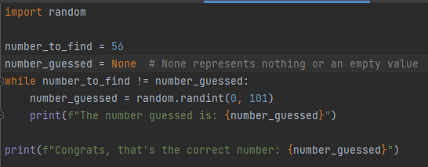
Type of Loops
Example: How to write a game to guess a number?

Slide 10
Type of Loops
Now, let’s improve this script to achieve the below example:
I am thinking of a number between 1 and 20. Take a guess. 10 Your guess is too low. Take a guess. 15 Your guess is too low. Take a guess. 17 Your guess is too high. Take a guess. 16 Good job! You guessed my number in 4 guesses!

Slide 11
Are you trapped in an infinite Loop?
What happens below? How to fix?
while True:
name = input(“Who are you?”)

Slide 12
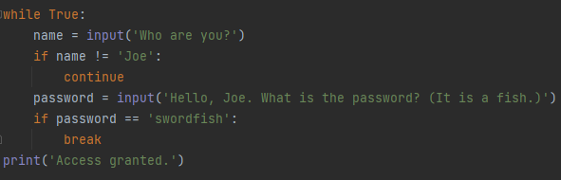
Trapped in an infinite Loop?
What happens below? How to fix?

Slide 13
Save your local changes to your GitHub
$ git status
$ git add .
$ git commit –m “A nicely message here”
$ git push

Slide 14
Thank you!

